Slide 1

Fundamentals of Containerization for ESOC
Andrew Monaghan
Andrew.Monaghan@colorado.edu
Please sign in:
https://tinyurl.com/y4aks9zs
Slides and course information available for download at
https://tinyurl.com/ts9s5hq

Slide 2
Outline
Introduction to containers
Overview: Singularity commands and running containers
Hands-on: Running containers on RMACC Summit
Notes: Running containers for MPI and GPU jobs
/\/\/ Break /\/\/
Overview: Building containers
Hands-on: Building containers from recipes (SingularityHub)
Demo: Building containers from recipes (Sylabs Remote Bldr)
Troubleshooting, caveats and summary

Slide 3
Introduction to Containers
Seacontainersales.com

Slide 4
What is a container?
A container is a portable environment that packages some or all of the following: an operating system, software, libraries, compilers, data and workflows. Containers enable:
Mobility of Compute
Reproducibility (software and data)
User Freedom

Slide 5
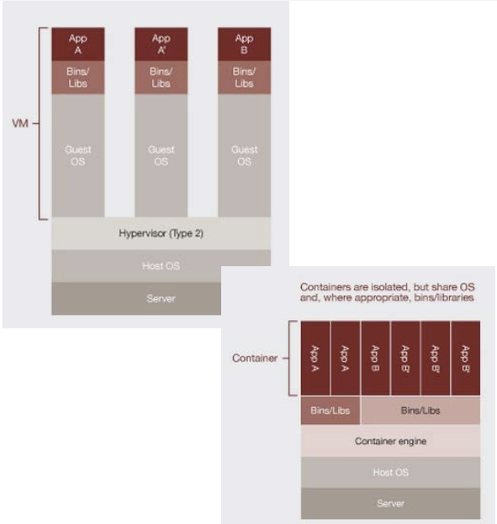
Virtualization (1)
Hardware virtualization (not used by containers!)
Can run many OS’s on same hardware (machine)
E.g., VirtualBox, VMWare
Material courtesy: M. Cuma, U. Utah

Slide 6
Virtualization (2)
OS-level virtualization (used by containers!)
Can run many isolated OS instances (guests) under a server OS (host)
Also called containers
E.g., Docker, Singularity
Best of both worlds: isolated environment that user wants, but can leverage host OS resources (network, I/O partitions, etc.)
Material courtesy: M. Cuma, U. Utah

Slide 7
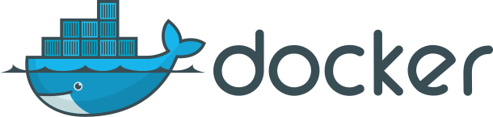

Containerization software
Docker
Well established – largest user base
Has Docker Hub for container sharing
Problematic with HPC
Charliecloud; Shifter
Designed for HPC
Based on Docker
Less user-friendly
Singularity
Primary focus of today’s tutorial
More info on next slide…

Slide 8
Why Singularity?
Singularity is a comparably safe container solution for HPC
User is same inside/outside container
User cannot escalate permissions without administrative privilege
Can support MPI and GPU resources on HPC (scaling)
Can use HPC filesystems
Supports the use of Docker containers
Container is seen as a file, and can be operated on as a file

Slide 9
Singularity Overview
Singularity Workflow
Key Commands
Running Containers
Seacontainersales.com

Slide 10
The Singularity Workflow
Need Container?
no
Build software in situ on host system
yes
Does Container Exist?
yes
Run existing container
no
Build Container
Run new container
Our focus today
Not covered today

Slide 11
Where do I find existing containers?
Docker Hub: https://hub.docker.com
Singularity Hub: https://singularity-hub.org
Sylabs Library: https://cloud.sylabs.io/library
Tutorial on finding a running an existing Docker container: https://www.chpc.utah.edu/documentation/software/singularity.php#exd

Slide 12
Key Singularity Commands
build: Build a container on your user endpoint or build environment
exec: Execute a command to your container
inspect: See labels, run and test scripts, and environment variables
pull: pull an image from Docker or Singularity Hub
run: Run your image as an executable
shell: Shell into your image
More: https://www.sylabs.io/guides/3.2/user-guide/cli.html

Slide 13
Running containers
Now, on any system with Singularity, even without administrative privilege, you can retrieve and use containers:
Download a container from Singularity Hub or Docker Hub
singularity pull shub://some_repo/some_image
singularity pull library://some_repo/some_image
singularity pull docker://some_repo/some_image
Run a container
singularity run mycont.sif
Execute a specific program within a container
singularity exec mycont.sif python myscript.py
“Shell” into a container to use or look around
singularity shell mycont.sif
Inspect an image
singularity inspect --runscript mycont.sif

Slide 14
Hands-on Examples
Running containers with Singularity
Seacontainersales.com

Slide 15
Logging in
If you are using a temporary account: In a terminal or Git Bash window, type the following:
ssh –X userNNNN@tlogin1.rc.colorado.edu
Password:
If you are using your regular RC account (e.g., ‘monaghaa’ for me), log in as you normally would:
ssh -X monaghaa@login.rc.colorado.edu
**Note that userNNNN is a temporary account that I have assigned to you, along with a password. If you do not have one, let me know.

Slide 16
Getting on a compute node
Navigate to scompile
ssh scompile
Now start an interactive job:
sinteractive –n 2 –t 180 –-reservation=container
Load singularity and set up environment
module load singularity/3.3.0
export SINGULARITY_TMPDIR=/scratch/summit/$USER
export SINGULARITY_CACHEDIR=/scratch/summit/$USER
…We will go through examples together in the following slides.

Slide 17
Running examples
Now type the following commands:
cd /scratch/summit/$USER
mkdir tutorial
cd tutorial
Now let’s run some examples. Go to the “tutorial.md” file in the course repository (https://tinyurl.com/ts9s5hq).

Slide 18
Building containers
Brief overview. See ‘Extra Slides’ if you have interest in examples.
Seacontainersales.com

Slide 19
There are 3 ways to build a Singularity container
Build a container on a system on which you have administrative privilege (e.g., your laptop).
Pros: You can interactively develop the container.
Cons: Requires many GB of disk space, requires administrative privilege, must keep software up-to-date, container transfer speeds can be slow depending on personal network connection.
Build a container on Singularity Hub using recipe, Github
Pros: Essentially zero disk space required on your system, doesn’t require administrative privilege, no software upgrades needed, easy to retrieve from anywhere, typically faster transfers from Singularity Hub to desired endpoint.
Cons: Cannot interactively develop the container
Build a container on Sylabs remote builder
Pros: Essentially zero disk space required on your system, doesn’t require administrative privilege, no software upgrades needed, easy to retrieve from anywhere, final container is placed on local machine
Cons: Cannot interactively develop the container, ‘Freemium’ version limited

Slide 20
/\/\/ BREAK /\/\/

Slide 21
Running “apt-insar”
In the course repository (https://tinyurl.com/ts9s5hq), click on the link to “apt-insar” under ”Agenda”. If you can’t find the link, here is the full path to the repository:
https://github.com/ResearchComputing/asf-insar-singularity
We will do the remaining exercises from this github repository.

Slide 22
Thank you!
Please fill out the survey:
http://tinyurl.com/curc-survey18
Contact information:
Andrew.Monaghan@Colorado.edu
Additional learning resources:
Slides and Examples from this course:
https://github.com/ResearchComputing/Containers_ESOC_Spring_2020
Web resources:
https://training.play-with-docker.com (docker online training materials)
https://hub.docker.com (Docker Hub)
https://www.sylabs.io/guides/3.4/user-guide/ (user guide for Singularity)
https://www.singularity-hub.org/ (Singularity Hub)

Slide 23
Extra slides
Seacontainersales.com

Slide 24
Building containers
Seacontainersales.com

Slide 25
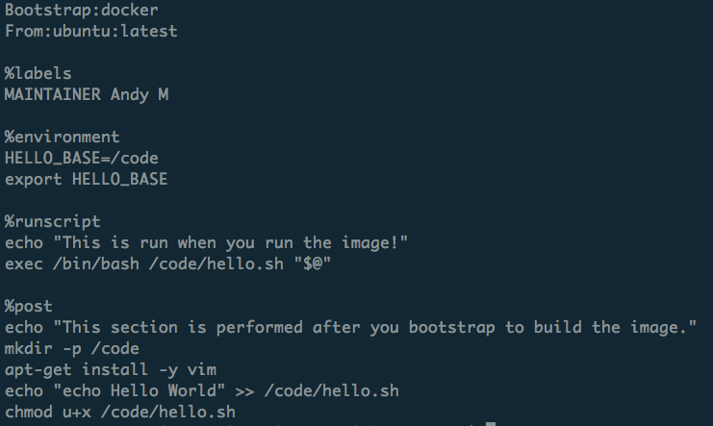
What is a recipe?
Header
Metadata
Runtime environment variables
Default program at runtime
Where software and directories are installed at buildtime
More: https://www.sylabs.io/guides/3.2/user-guide/definition_files.html

Slide 26
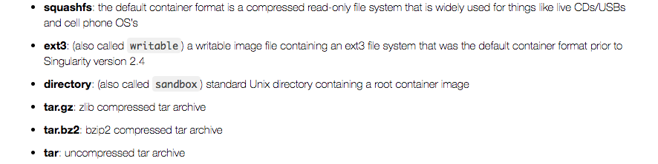
Container Formats
*.sif format and older *.simg format
(immutable final container format)
Writeable sandbox used for interactive container development
https://singularity.lbl.gov

Slide 27
1. Building a container interactively (demo)
Bootstrap a base container (has OS you want, maybe other stuff too) into a sandbox:
sudo singularity build --sandbox mytest/ docker://alpine:latest
Shell into the container and install what you need by trial and error:
sudo singularity shell –-writable mytest/
[now do stuff in container; as you get it correct, add commands to Singularity recipe]
Now finalize container.
You can either build squashfs image from sandbox:
sudo singularity build mytest.sif mytest/
Or you can build squashfs image from recipe (best practice):
sudo singularity build mytest.sif Singularity

Slide 28
2. Building a container on Singularity Hub (basic steps)
Create a recipe file for your container
Name it “Singularity”
Create a github repository for your container
Upload it to your github repository
Log into Singularity Hub using your github username/password
Go to “My Collections” and choose “ADD A COLLECTION”
Select the github repository you just uploaded.
The container will build automatically.
Revised recipes are automatically rebuilt when pushed to github.
Additional details at: https://github.com/singularityhub/singularityhub.github.io/wiki
**Note: You can build Docker containers on Docker Hub using a nearly identical process!

Slide 29
3. Building a container with Sylabs Remote Builder (demo)
Get a token from Sylabs Cloud: https://cloud.sylabs.io/auth
Login using your Github account
Provide a label under “Create a New Access Token”
Click “Create New Token”
Copy the token string (<your-token>)
Add the token on your host machine:
mkdir ~/.singularity
echo “<your-token>” > ~/.singularity/sylabs-token
Issue the command to build your container remotely
singularity build --remote myimage.sif myrecipe.def
If successful, the container will be placed in your working directory

Slide 30
Notes: MPI and GPUs
Seacontainersales.com

Slide 31
Notes: MPI-enabled containers
Teton uses an the Infiniband low-latency interconnect (“fabric”) to enable MPI to be efficiently implemented across nodes). In order to use a Singularity container with OpenMPI (or any MPI) on Teton, there are two requirements:
The Singularity container needs to have the Infiniband libraries installed inside.
OpenMPI needs to be installed both inside and outside of the Singularity container. More specifically, the SAME version of OpenMPI needs to be installed inside and outside (at least very similar, you can sometimes have two different minor versions, ex: 2.1 and 2.0).
An example Singularity recipe in the tutorial Github repository named “Singularity_openmpi.def” can be used as a template to build MPI-enabled container images for Teton. It has the Infiniband libraries and ensures that OpenMPI 3.1.0 is installed in the image, which matches the openmpi/3.1.0 module available on Teton.

Slide 32
Running containers on GPUs
Syntax (after loading Singularity on a gpu node):
singularity exec --nv docker://tensorflow/tensorflow:latest-gpu python mytensorflow_script.py
With the --nv option the driver libraries do not have to be installed in the container. Instead, they are located on the host system (e.g., Teton) and then bind mounted into the container at runtime. This means you can run your container on a host with one version of the NVIDIA driver, and then move the same container to another host with a different version of the NVIDIA driver and both will work. (Assuming the CUDA version installed in your container is compatible with both drivers.)
The NVIDIA Driver version on a GPU node can be queried (when on that node) with the command nvidia-smi. See https://docs.nvidia.com/deploy/cuda-compatibility/
You can build a container by bootstrapping a base NVIDIA CUDA image (with a compatible CUDA version) from: https://hub.docker.com/r/nvidia/cuda/
NVIDIA has a tool for building gpu-enabled containers for both Singularity and Docker. See: https://github.com/NVIDIA/hpc-container-maker

Slide 33
Troubleshooting and Caveats
Seacontainersales.com

Slide 34
Troubleshooting (1)
Container/host environment conflicts
Container problems are often linked with how the container “sees” the host system. Common issues:
The container doesn’t have a bind point to a directory you need to read from / write to
The container will “see” python libraries installed in your home directory (and perhaps the same is true for R and other packages. If this happens, set the PYTHONPATH environment variable in your job script so that it points to the container paths first.
export PYTHONPATH=<path-to-container-libs>:$PYTHONPATH
To diagnose the issues noted above, as well as others, “shelling in” to the container is a great way to see what’s going on inside. Also, look in the singularity.conf file for system settings (can’t modify).

Slide 35
Troubleshooting (2)
Failures during container pulls that are attributed (in the error messages) to *tar.gz files are often due to corrupt tar.gz files that are downloaded while the image is being built from layers. Removing the offending tar.gz file will often solve the problem.
When building ubuntu containers, failures during %post stage of container builds from a recipe file can often be remedied by starting the %post section with the command “apt-get update”. As a best practice, make sure you insert this line at the beginning of the %post section in all recipe files for ubuntu containers.
https://singularity.lbl.gov

Slide 36
Caveats (1)
We didn’t cover overlays. These are additional images that are ”laid” on top of existing images, enabling the user to modify a container environment without modifying the actual container. Useful because:
Overlay images enable users to modify a container environment even if they don’t have root access (though changes disappear after session)
Root users can permanently modify overlay images without modifying the underlying image.
Overlays are a likely way to customize images for different HPC environments without changing the underlying images.
More on overlays: http://singularity.lbl.gov/docs-overlay
We didn’t cover GPU usage with containers. See: http://singularity.lbl.gov/archive/docs/v2-3/tutorial-gpu-drivers-open-mpi-mtls

Slide 37
Caveats (2): Moving containers
You’ve built your first container on your laptop. It is 3 Gigabytes. Now you want to move it to Summit to take advantage of the HPC resources. What’s the best way?
Remember, containers are files, so you can transfer them to Summit just as you would a file:
Command line utilities (scp, sftp)
Globus (recommended)
For more on data transfers to/from Summit: https://github.com/ResearchComputing/Research-Computing-User-Tutorials/wiki/Data-Transfers

